Slide 1
Result oriented
From
Ownership

Slide 2
"I am aware of the impact and I own it" Taking personal responsibility for the tasks, projects and for the organization.
Why Ownership ?

Slide 3
Objective:
What is Result oriented?
2. What is my understanding about being result oriented?
3. How we can implement result oriented in work life?

Slide 4
What is result oriented ?
"Focusing on outcomes rather than output"
Output: An output is a tangible or observable result of specific activities or tasks
Outputs are the activities we do or accomplish that help achieve outcome.
Outcome: An outcome is a desired result or consequences of an action or a series of action
It reflects the overarching goal you aim to achieve

Slide 5


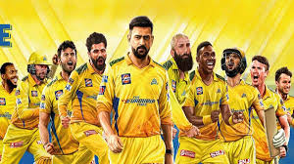


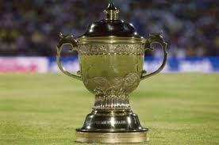

Output and outcome example:
IPL match
VS
OUTCOME
OUTPUT

Slide 6
In this field our main aim is to satisfy the clients, who are the source of profit for our organization. If we only focus on the output we can't achieve the 100% of our goal.
What is my understanding about result oriented ?
Example: Micro project

Slide 7
How we can implement result oriented in work life ?
Setting up clear goals
Focusing on the task and the activities that are related to achieving the results
Making sure that I'm in a right track towards achieving the outcome
Understanding the main intend of the product so that I can able to deliver a wise output
Which will we very helpful to achieve the outcome.

Slide 8
Conclusion:
"Own the outcome not the output"

Slide 9

Question & Answer

Slide 10
Keerthivasan Kamalakannan

